Slide 1
Normalization
Presented By:
Sakshyam Tamrakar
Sameer Maharjan
Siddhartha Shakya

Slide 2
Introduction to Database Normalization
Process of organizing data to reduce redundancy and improve consistency.
Helps in designing efficient, scalable, and easy-to-maintain databases.
Generally involves splitting tables into multiple linked tables

Slide 3
Why Do We Need Normalization?
Eliminate Data Redundancy
Avoid Inconsistencies during:
  Insert
  Update
  Delete

Slide 4
Normal Forms in DBMS
First Normal Form (1NF)
Second Normal Form (2NF)
Third Normal Form (3NF)
Boyce-Codd Normal Form (BCNF)
Fourth Normal Form (4NF)
Fifth Normal Form (5NF)

Slide 5
First Normal Form (1NF)
A relation is in 1NF if:
All attributes contain atomic (single) values
Each record must be unique
No multiple values in a single cell

Slide 6
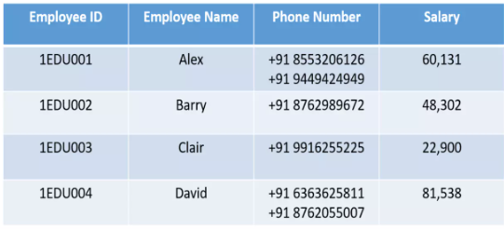
1NF Example

Slide 7
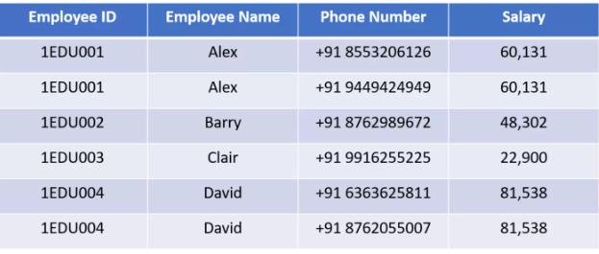
1NF Example

Slide 8
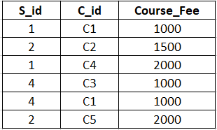
Second Normal Form (2NF)
In 2NF there should not be partial dependency.
The table first needs to be in 1NF.
Example:
S_id and C_id =composite primary key
Course_Fee = non primary attribute

Slide 9
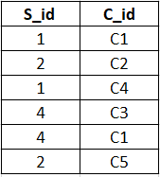
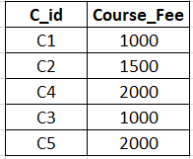
1. Student_Course Table
2. Courses Table

Slide 10
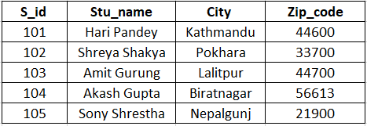
Third Normal Form (3NF)
In 3NF there should not be transitive dependency in the table.
The table first needs to be in 2NF.
Example:
S_id is a primary key
S_id → Zip_code → City

Slide 11
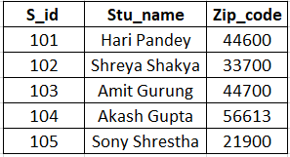
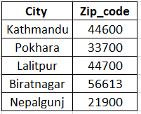
1. Student Table
2. City Table

Slide 12
Boyce-Codd Normal Form (BCNF)
BCNF is the advance and stricter version of 3NF. A relation is in BCNF if:
The relation is in 3rd normal form.
X should be a candidate key or super key for every functional dependency
(FD) X -> Y in a given relation.

Slide 13


Boyce-Codd Normal Form (BCNF)
student_id | course | instructor
S01 | Database | Prof. Smith
S02 | Database | Prof. Smith
S03 | Networks | Prof. Johnson
S04 | Networks | Prof. Johnson
S05 | AI | Prof. Lee
Functional Dependancies:
(student_id,course) → instructor
Instructor → course
Candidate key: (student_id, course)
Check BCNF:
(student_id,course) → instructor (Left side is a super key or candidate key.
instructor → course (Left side is not a super key or candidate key.

Slide 14
Convert into BCNF (Decompose)
instructor | course
Prof. Smith | Database
Prof. Johnson | Networks
Prof. Lee | AI
student_id | instructor
S01 | Prof. Smith
S02 | Prof. Smith
S03 | Prof. Johnson
S04 | Prof. Johnson
S05 | Prof. Lee
Relation R1: (instructor, course)
From FD: instructor -> course
Candidate key: instructor
Relation R2: (student_id, instructor)
Candidate key: (student_id, instructor)

Slide 15
Fourth Normal Form (4NF)
A relation is in 4NF if:
The relation is in BCNF.
The relation should not have multivalued dependancy.

Slide 16
Example of 4NF violation
student | subject | hobby
John | Math | Chess
John | Math | Painting
John | Science | Chess
John | Science | Painting
Multivalued Dependancies:
student ->> subject
student ->> hobby
Subject and hobby are independent of each other

Slide 17
Convert into 4NF
student | subject
John | Math
John | Science
Relation R1: (student, subject)
student | hobby
John | Chess
John | Painting
Relation R2: (student, hobby)

Slide 18
Thank You

